Slide 1





Database Transactions
Transaction Management and Concurrency Control
SoftUni Team
Technical Trainers
Software University
http://softuni.bg
Notes:
SLAIDA OT ITALY ZA row / page level

Slide 2


Agenda
Transactions
The Magical “ACID” Word
Locks and SQL Server Concurrency
Troubleshooting Locking Problems
Transaction Isolation Levels
Notes:
Why do we have them what so ever and how they work?
What problems they cause and how to fix those
What every isolation level can do for us and how may it help!

Slide 3
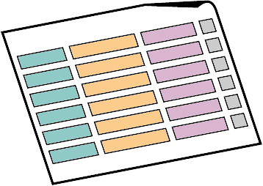


What is a Transaction?

Slide 4
Transactions
Transaction is a sequence of actions (database operations) executed as a whole:
Either all of them complete successfully
Or none of the them
Example of transaction:
A bank transfer from one account into another (withdrawal + deposit)
If either the withdrawal or the deposit fails the whole operation is cancelled

Slide 5
Transactions: Lifecycle
Read
Write
Durable starting state
Sequence of reads and writes
Durable,
consistent,
ending state
Write
Commit
Rollback

Slide 6
Transactions Behavior
Transactions guarantee the consistency and the integrity of the database
All changes in a transaction are temporary
Changes are persisted when COMMIT is executed
At any time all changes can be canceled by ROLLBACK
All of the operations are executed as a whole
Either all of them or none of them

Slide 7
Transactions: Example
Withdraw $100
Transfer $100
Read current balance
New balance = current - $100
Write new balance
Dispense cash
Read savings
New savings = current - $100
Read checking
New checking = current + $100
Write savings
Write checking
Notes:
Can be looked at as one transaction -> transferring money from one place to another (without step 4)

Slide 8
What Can Go Wrong?
Some actions fail to complete
For example, the application software or database server crashes
Interference from another transaction
What will happen if several transfers run for the same account in the same time?
Notes:
Use transfer example, not cash machine for failing to complete

Slide 9
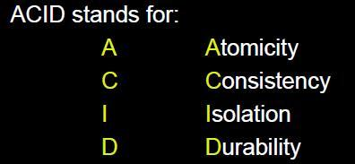


ACID Transactions

Slide 10


Transactions Properties
Modern DBMS servers have built-in transaction support
Implement “ACID” transactions
E.g. MS SQL Server, Oracle, MySQL, …
ACID means:
Atomicity
Consistency
Isolation
Durability

Slide 11

Atomicity
Atomicity means that
Transactions execute as a whole
DBMS to guarantee that either all of the operations are performed or none of them
Atomicity example:
Transfer funds between bank accounts
Either withdraw + deposit both execute successfully or none of them
In case of failure the DB stays unchanged

Slide 12

Consistency
Consistency means that
The database is in a legal state when the transaction begins and when it ends
Only valid data will be written in the DB
Transaction cannot break the rules of the database, e.g. integrity constraints
Primary keys, foreign keys, alternate keys
Consistency example:
Transaction cannot end with a duplicate primary key in a table

Slide 13

Isolation
Isolation means that
Multiple transactions running at the same time do not impact each other’s execution
Transactions don’t see other transaction’s uncommitted changes
Isolation level defines how deep transactions isolate from one another
Isolation example:
If two or more people try to buy the last copy of a product, just one of them will succeed.

Slide 14

Durability
Durability means that
If a transaction is committed it becomes persistent
Cannot be lost or undone
Ensured by use of database transaction logs
Durability example:
After funds are transferred and committed the power supply at the DB server is lost
Transaction stays persistent (no data is lost)

Slide 15



Managing Transactions in SQL

Slide 16
Transactions and SQL
Start a transaction
BEGIN TRANSACTION
Some RDBMS use implicit start, e.g. Oracle
Ending a transaction
COMMIT
Complete a successful transaction and persist all changes made
ROLLBACK
“Undo” changes from an aborted transaction
May be done automatically when failure occurs

Slide 17
Transactions in SQL Server: Example
We have a table with bank accounts:
We use a transaction to transfer money from one account into another
CREATE TABLE Accounts(
Id int NOT NULL PRIMARY KEY,
Balance decimal NOT NULL)
CREATE PROCEDURE sp_Transfer_Funds(
@from_account INT,
@to_account INT,
@amount MONEY) AS
BEGIN
BEGIN TRAN;
(example continues)

Slide 18
Transactions in SQL Server: Example (2)
UPDATE Accounts SET Balance = Balance - @amount
WHERE Id = @from_account;
IF @@ROWCOUNT <> 1
BEGIN
ROLLBACK;
RAISERROR('Invalid src account!', 16, 1);
RETURN;
END;
UPDATE Accounts SET Balance = Balance + @amount
WHERE Id = @to_account;
IF @@ROWCOUNT <> 1
BEGIN
ROLLBACK;
RAISERROR('Invalid dest account!', 16, 1);
RETURN;
END;
COMMIT;
END;
Notes:
Checks if the number of returned rows is more than 1

Slide 19
Auto Commit Transactions
Default transaction mode
Every TSQL statement is committed or rolled back on completion
Compile errors result in entire batch not being executed
Run time errors may allow part of the batch to commit
---run time error - partially executed
USE AdventureWorks2012;
GO
CREATE TABLE TestBatch (Cola INT PRIMARY KEY, Colb CHAR(3));
GO
INSERT INTO TestBatch VALUES (1, 'aaa');
INSERT INTO TestBatch VALUES (2, 'bbb');
INSERT INTO TestBatch VALUES (1, 'ccc'); -- Duplicate key error.
GO
SELECT * FROM TestBatch; -- Returns rows 1 and 2.
GO
Notes:
Every Transact-SQL statement is committed or rolled back when it completes. If a statement completes successfully, it is committed; if it encounters any error, it is rolled back.

Slide 20
Implicit Transactions
SQL Server is responsible for opening the transaction
We are responsible for committing or rolling it back
Can be turned on from Connections tab in Server Properties
SET IMPLICIT_TRANSACTIONS ON
USE AdventureWorks2012
GO
UPDATE [Person].[Address]
SET AddressLine1='SoftUni, Sofia'
WHERE AddressID=2
COMMIT
– this will write a change to the db
SET IMPLICIT_TRANSACTIONS ON
USE AdventureWorks2012
GO
UPDATE [Person].[Address]
SET AddressLine1='SoftUni, Sofia'
WHERE AddressID=2
ROLLBACK
– this will not write a change to the db

Slide 21
Explicit Transactions
A transaction in which start and end of transaction is explicitly declared
BEGIN TRANSACTION
COMMIT TRANSACTION OR ROLLBACK TRANSACTION
XACT_ABORT ON/OFF – control the rollback behavior
SET XACT_ABORT ON – if run time error is generated everything is rolled back
USE AdventureWorks2012 GO
BEGIN TRANSACTION FundsTransfer
GO
EXEC HumanResources.DebitAccount '100', 'account1';
EXEC HumanResources.CreditAccount '100', 'account2';
COMMIT TRANSACTION;
Notes:
Mention try - catch

Slide 22
Managing Transactions in SQL
Demo

Slide 23

Locks and SQL Server Concurrency

Slide 24
Methods of Concurrency Control
Pessimistic
Data is locked to prevent concurrency problems
SQL Server uses locks, causes blocks and who said deadlocks?
Optimistic
SQL Server generates versions for everyone, but the updates…
Notes:
How SQL Server controls the access between your users to the resources inside the database
In pessimistic you are worried that someone will modify the data you work with and that’s why SQL helps with locks. Thus ensuring the consistency of the data between the users
In Optimistic you have your own version of the data and quite less locks, but you hit tempdb and some update conflicts which we will talk later for

Slide 25
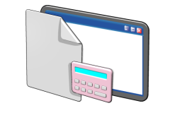




What Are Locks and What is Locking?
Lock – internal memory structure that “tells” us what we all do with the resources inside the system
Locking – mechanism to protect the resources and guarantee consistent data
Notes:
Once we know the concurrency levels and that they are using locks to guarantee data consistency what are locks?
Locks – Am I reading, Am I writing?
Locks – up to 60% of the buffer pool
Each is taking around 100 bytes per lock (32 bit – 64, 64 bit – 128)
How much memory is used – locks on server level (decommissioned) – 2500 or 2% of the memory

Slide 26
Common Lock Types
Shared (S)
Used for: Reading
Duration: Released almost immediately (depends on the isolation level)
Update (U) Used for: Preparing to modify Duration: End of the transaction or until converted to exclusive (X)
Intent Used for: Preventing incompatible locks Duration: End of the transaction
Exclusive (X)
Used for: Modifying Duration: End of the transaction
Notes:
Shared – reading / depends how long will be held and when will be released
Exclusive – modify / always till the end – why? Example with rollback!
Update – preparing to modify – while searching which rows needs to be updated it puts update lock. Always convert to exclusive
Intent lock – used for letting now the Lock Manager that someone works with the DB in some way in the higher level in the hierarchy
And there are a lot more locks – schema locks, Bulk update locks and more, but we definitely do not have time for that! (combinations too)

Slide 27
Lock Compatibility
Not all locks are compatible with other locks
Lock | Shared | Update | Exclusive
Shared (S) |  |  | X
Update (U) |  | X | X
Exclusive (X) | X | X | X
Notes:
Not all are compatible with one another and that’s why we wait sometimes (there’s blocking)
Update is friendly enough with the shared – it will not make sense otherwise
Exclusive – not that much
More on the link
SIX - convert lock. Example – shared lock on a row now has to become X lock. However, for the exclusive to occur, we ed IX in the upper levels – that is the moment when we convert our S and IS locks to X and SIX locks

Slide 28
Lock Hierarchy
Database
Table
Page
Row
Notes:
Every transaction you issue has to put locks on all of the levels
Why? Because otherwise SQL Server and Lock manager will not be aware what’s going on in this database
What will stop me, what will tell me that someone is modifying a row if I don’t place a locks above in the hierarchy?
Shared lock always on the database – tell the exclusions – mater and tempdb – SHARED_TRANSACTION_WORKSPACE and EXCLUSIVE_TRANSACTION_WORKSPACE
No way to drop / restore / put the master / tempdb to read_only

Slide 29
Let’s Update a Row! What Do We Need?
S
USE AdventureWorks2012
GO
UPDATE [Person].[Address]
SET AddressLine1='SoftUni, Sofia'
WHERE AddressID=2
IX
Header
Row
Row
Row
Row
Row
IX
X

Slide 30



Methods to View Locking Information
Dynamic Management Views
SQL Server Profiler or Extended Events
Performance monitor or Activity Monitor
Notes:
Various, various ways… sp_whoisactive
Dynamic Management Views
System stored procedures
SQL Profiler
Performance Monitor counters
Blocked Process Report
Deadlock events and trace flag 1222
SQL Server 2008 adds
Performance Data Collection
Extended Events

Slide 31

Troubleshooting Locking Problems

Slide 32
Locking and Blocking
Locking and blocking are often confused!
Locking
The action of taking and potentially holding locks
Used to implement concurrency control
Blocking is result of locking!
One process needs to wait for another process to release locked resources
In a multiuser environment, there is always, always blocking!
Only a problem if it lasts too long
Notes:
LOCK_TIMEOUT -> next statement continues!!! Session level option! Throws 1222
(READPAST) hint – reads what it is able to and moves forward

Slide 33
Lock Escalation
S
S
IX
IX
X
Header
Row
Row
Row
Row
Row
X
X
>= 5000
X
X
Notes:
Start with what escalation is!
SQL Server decides (during compilation) the granularity of locks to be used:
Row
Page
Lock granularity can be controlled via LOCK HINTS (PAGLOCK, TABLOCKX…)
Escalation always happens this way:
Row -> table lock (or partition lock if possible)
Page -> table lock (or partition lock if possible)
Lock escalation can be disabled:
Trace flag 1211 – disables lock escalation on server level
Trace flag 1224 – disables lock escalation on server level until 40% of the memory used is consumed
- Or 5000 locks on one object / index / table scan!
If escalation fails because of incompatible lock – sql server waits for another 1250 locks
(partitioning) – auto to partition from 2008 + enterprise
Escalating in case of 40% of the memory used for locks if the locks option is not set to 0
Escalating in case of 24% of the memory used for locks if the locks option is set to 0

Slide 34
Controlling Lock Escalation
Switch the escalation level (per table)
AUTO – Partition-level escalation if the table is partitioned
TABLE – Always table-level escalation
DISABLE – Do not escalate until absolutely necessary
Just disable it (that’s not Nike’s “Just do it!”)
Trace flag 1211 – disables lock escalation on server level
Trace flag 1224 – disables lock escalation if 40% of the memory used is consumed
SELECT lock_escalation_desc FROM sys.tables WHERE name = 'Person.Address'
ALTER TABLE Person.Address SET (LOCK_ESCALATION = {AUTO | TABLE | DISABLE}
Notes:
Disable – in case of serialization isolation level and table scan – table lock will be acquired
Not the way to resolve your problems, just a workaround!
Auto not default in partitioning because can cause deadlocks

Slide 35



What Are Deadlocks?
Who is victim?
Cost for Rollback
Deadlock priority – SET DEADLOCK_PRIORITY
Task A
Resource 1
Task B
Resource 2
Notes:
Priorities -> cost -> random
LOCK_MONITOR checks every 5 seconds for deadlock and every 100ms if one is detected till no others are detected
Some operations cannot be chosen for deadlock victims (rollbacks)
Error 1205 should be handled, 1204 and 1222
Cycle and conversion deadlocks

Slide 36
Resolve Blocking
Keep the transactions as short as possible
No user interactions required in the middle of the transaction
Use indexes (proper ones)
Consider a server to offload some of the workloads
Choose proper isolation level
Notes:
Cursors – when it takes lock and on what and when it releases them

Slide 37
Locks and SQL Server Concurrency
Live Demo
Notes:
START THE LIVE DATA + BLOCKED PROCESSES REPORT
So we are going to see:
monitoring (Remind that the events in Profiler are the same)
lock escalation
deadlock control scribe other alternatives – perfmon, activity monitor, sp_whoIsActive, sp_who2

Slide 38
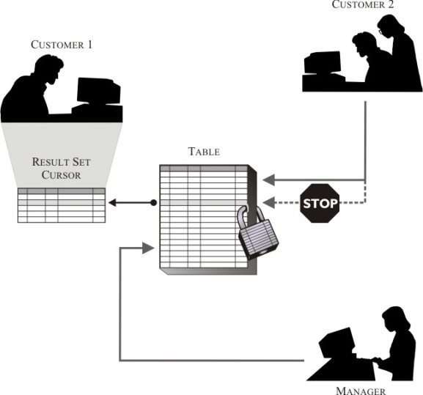
Transaction Isolation Levels
Live Demo
Notes:
Example with all levels
sp_whoisactive @get_additional_info=1

Slide 39
Read Uncommitted
SET TRANSACTION ISOLATION LEVEL READ UNCOMMITTED (NOLOCK?)
eXclusive lock
Transaction 1
UPDATE
SELECT
Transaction 2
Dirty read
Suggestion:
Better offload the reads or go with optimistic level concurrency!
Notes:
- Going down the concurrency first – seeing data that is not committed
- Dirty read – when you read uncommitted data

Slide 40
Repeatable Read
SET TRANSACTION ISOLATION LEVEL REPEATABLE READ
Transaction 1
S(hared) lock
SELECT
Transaction 2
UPDATE
No non-repeatable reads possible (updates during Transaction 1)
Phantom records still possible (inserts during Transaction 1)
Notes:
- Go higher – more locks! that’s the prize
- No nonrepeatable reads
- S lock is held until the end of the transaction in order to read the same data
- Every transaction that has to update rows has to wait until T1 completes

Slide 41
Serializable
SET TRANSACTION ISOLATION LEVEL SERIALIZABLE
S(hared) lock
Transaction 1
SELECT
Transaction 2
INSERT
Even phantom records are not possible!
Highest pessimistic level of isolation, lowest level of concurrency
Notes:
- Go higher - Repeatable Read + Holding the locks for a zone of rows
- + 1 and – 1 in the range, but you have to have a good index for this to happen otherwise table scan!
- Cannot insert more data in the range Entity Framework and LYNC – EF does it automatically without you stating it

Slide 42
Optimistic Concurrency
Based on row versioning
(stored inside tempdb’s version store area)
No dirty, non-repeatable reads or phantom records
Every single modification is versioned even if not used
Adds 14 bytes per row
Readers do not block writers and writers do not block readers
Writers can and will block writers, this can cause conflicts!
Notes:
Old version goes to tempdb – per row 14 bytes for the new writes only (not KB, bytes!)
- consist the XSN of the transation that generated the version + the pointer to the old version in tempdb
Committed versions go into database
Every single modification is versioned! (with the exception of inserts)
AlwaysOn readable secondary turns on Snapshot isolation level

Slide 43
Read Committed and Snapshot Isolation Levels
RCSI – Read Committed Snapshot Isolation Level
Statement level versioning
Requires ALTER DATABASE SET READ_COMMITTED_SNAPSHOT ON
Snapshot Isolation Level
Transaction level versioning
Requires ALTER DATABASE SET ALLOW_SNAPSHOT_ISOLATION ON
Requires SET TRANSACTION ISOLATION LEVEL SNAPSHOT
Transaction 1
V1
V2
Select
Select in RCSI
Transaction 2
Select in SI
Notes:
Statement level versions
RCSI – Read Committed, but with versions
No code changes, but you have to throw everyone from the db
SI – Repeatable read – a lot more tempdb usage
Transaction level versions
Requires code change
Can be used together
Only SI ON – using still locks, but with versions generated you have to REQUEST it with Set transaction…

Slide 44
Concurrency Phenomenon in Isolation Levels
Level of Isolation | Dirty Reads | Repeatable Reads | Phantom Reads
Read uncommitted | yes | yes | yes
Read committed | no | yes | yes
Repeatable read | no | no | yes
Serializable | no | no | No
Read Committed Snapshot | no | no | yes
Snapshot | no | no | no

Slide 45
Transaction Isolation Levels
Live Demo
Notes:
Example with all levels
sp_whoisactive @get_additional_info=1

Slide 46


Summary
Transactions
The magical “ACID” word
Locks and SQL Server Concurrency
Troubleshooting locking problems
Transaction Isolation Levels
Databases
Notes:
Why do we have them what so ever and how they work?
What problems they cause and how to fix those
What every isolation level can do for us and how may it help!

Slide 47







Database Transactions
https://softuni.bg/courses/databases

Slide 48
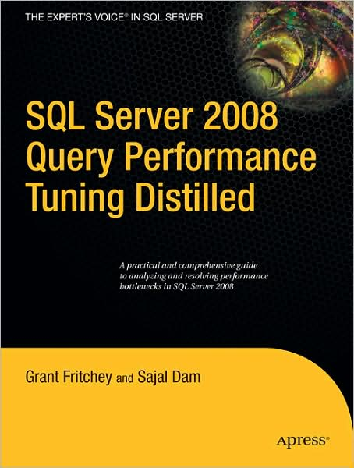
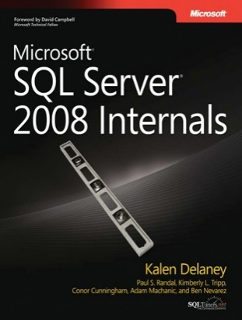
Resources
MCM Readiness videos on locking lecture and demo
MCM Readiness video on Snapshot Isolation Level
http://blogs.msdn.com/b/bartd/archive/tags/sql+locking
http://www.sqlskills.com/blogs/paul/category/locking/
Lock hints – http://www.techrepublic.com/article/control-sql-server-locking-with-hints/5181472

Slide 49
License
This course (slides, examples, demos, videos, homework, etc.) is licensed under the "Creative Commons Attribution-NonCommercial-ShareAlike 4.0 International" license
Attribution: this work may contain portions from
"Databases" course by Telerik Academy under CC-BY-NC-SA license

Slide 50





Free Trainings @ Software University
Software University Foundation – softuni.org
Software University – High-Quality Education, Profession and Job for Software Developers
softuni.bg
Software University @ Facebook
facebook.com/SoftwareUniversity
Software University @ YouTube
youtube.com/SoftwareUniversity
Software University Forums – forum.softuni.bg

